Slide 1
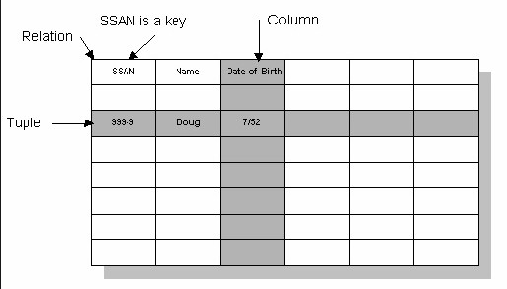
IT1768 - Database Systems
Topic 4 :
Relational Data Model
click hyperlink below & view from 12:00 min onward:
Reference Source: https://www.youtube.com/watch?v=4Z9KEBexzcM

Slide 2
Unit 4 : Relational Data Model
Objective :
At the end of this unit, you should be able to:
  list the associated elements of relational data model such as types of entities, attributes and different degree of relationships.
  classify the relationships, cardinalities and the notation used in Entity Relationship Diagram (ERD).
  produce a simple type of Entity Relationship Diagram (ERD).

Slide 3
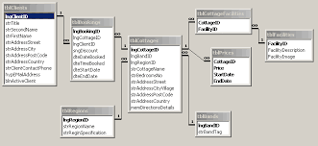
Why use relational data model ?
In relational data model, data can be organized into tables.
Entity
attributes
relationship
Foreign key
Primary key
Relational data model produces relational database, from which data can be manipulated using SQL (Structural Query Language).

Slide 4
3-Level Architecture of Database
1) Database planning
Activity
The 3-Level Architecture of Database
2) Data collection & analysis
Interview, Survey reports
Survey user requirements, gathered data, formulate system requirements
Summarise into Scenario
External Level
Relational modelling
Conceptual Level
3) Database design
Entity Relationships Modelling
Internal Level
Create Relational Database
4) Database implementation
Data migration & Testing
5) Data conversion & Loading

Slide 5
Entity-Relationship Diagram
Relational model & Entity-Relationsip Diagram
cardinality
Entity
attributes
relationship
Foreign key
Primary key

Slide 6
Relational Modelling
User requirements & data consolidaation
Entities
Attributes
Business Rules >> Cardinalities
Relationships
Data schema & Constraints
(e.g. Referential integrity constraint)

Slide 7
Database Development
What constitutes an established database?
Normalized relations
Constraints
No insert anomaly
Entity (Key) constraints
No delete anomaly
Referential Integrity constraints
No update anomaly
Established Database
Domain constraints
Data Retrieval
System Administration
Ease of data retrieval
Ease of system maintenance

Slide 8
Relational Modelling - Entities
1) Clustering of data & Entities
By database design, consolidated data can be categorised into different entities (relations/tables).
- For example, based on the scenario, the operation in a trading company can be represented by the following entities (including associated fields / attributes).
PRODUCTS
ProdID
ProdName
UnitPrice
Supplier
DEPARTMENT
DepID
DepName
DepNo
EMPLOYEES
EmpID
EmpName
Gender
DepNo
SALES
SalesID
Items
Quantity
DateSales
These entities come with applicable attributes but with no data yet

Slide 9
Relational Model - Relationships
2) Establishment of relationships between Entities
Inter-related entities connected to each other by relationships, these relationships associated the operational activities (business rules) of the two adjacent entities.
e.g. Entities ‘EMPLOYEES’ & ‘DEPARTMENT’
e.g. Entities ‘EMPLOYEES’ & ‘PAYCHECK’
A relationship constitutes of :
Association tie connecting the entities,
Cardinalities at both end of the ties,
Action word describes the purpose that each entity play in the relationship.
EMPLOYEES
EmpID
EmpName
Gender
DepNo
3
PAYCHECK
PCheckID
Amount
DatePaid
Remark
2
Receive
2
1

Slide 10
Business rules & Cardinalities
3) Business rules embedded in the relationships
Business rules is the imposed restriction on the business’s activities that must be reflected in the database and database applications, for example:
  One Bank Customer can have at least one or more Accounts.
  One Bank Account is assigned to one and only Customer.
By reflecting these business rules in the relationships, cardinalities or structural constraints are included.
CUSTOMERS
Set Up
ACCOUNTS
Interpretation:
One customer can set up one or many accounts.
An account is set up for one and only one customer.

Slide 11
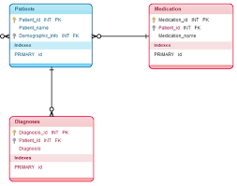
Entity Relationship Diagram (ERD)
Entity Relationship Diagram (ERD) = Entities + Relationships
Entity Relationship Diagram comprises of entities (with attributes) and relationships. The relationship associates the two adjacent entities
Entity Relationship Diagram (partially completed)

Slide 12
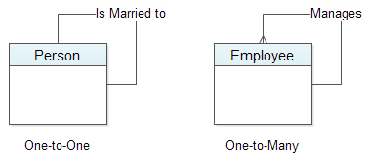
Different Degree of Relationships
Different degrees of Relationships
The degree of the relationship : It refers to the number of participating entities in the relationship.
  There are:
  - Degree 1 : unary relationship
  - Degree 2 : binary relationship
  - Degree 3 : ternary relationship
  - Degree 4 : quaternary relationship
D1
Unary Relationship
PersonID
PersonName
EmpID
Designation
D2
Binary Relationship
PersonID | PersonName | Spouse
P1 | John | Mary
P2 | Mary | John
EMPLOYEES
EmpID
EmpName
Gender
DateBorth
DEPARTMENT
DepID
DepName
MainLine
Manager
work
*(This will be our focus of study)

Slide 13
Different Degree of Relationships
Ternary & Quaternary Relationships
D3
D4
Ternary Relationship
Quaternary Relationship
SolicitorR
SolicitorID
Company
BUYER
BuyerID
BuyerAddr
BUYER
BuyerID
Address
FINANCE
InstituteID
InstName
Negotiate
Price
Arrange
SELLER
SellerID
Address
AGENT
AgentID
InstName
BID
BidCode
DateBid
A data model defines a semantically significant interaction between four independent entity-types

Slide 14
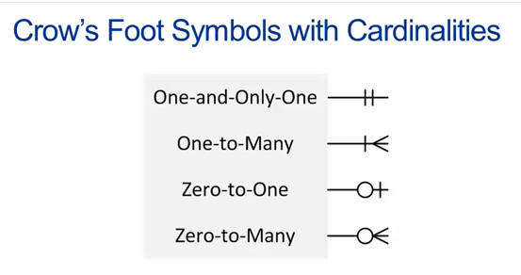
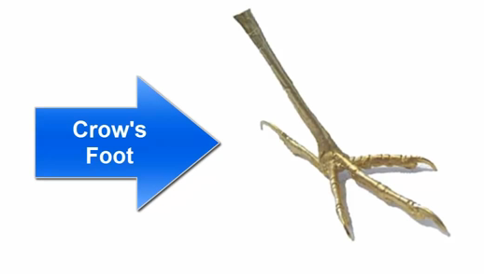
Cardinalities & Notation
Cardinality refers to the number of times instances in one entity can be related to instances in another entity.
In our studies, only binary relationship models will be used for illustration with Crow’s Foot notation
There are four (4) types of cardinalities (denoting the minimum & maximum values):
ENTITY
ENTITY
ENTITY
The Crow’s Foot
ENTITY

Slide 15
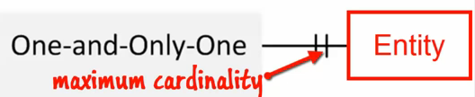
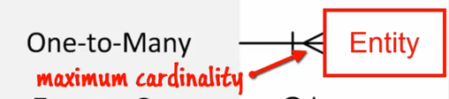
Interpretation on Cardinality
The Maximum and Minimum Cardinalities in a relationship:
One-and-only one cardinality
Minimum cardinality
One-to-Many cardinality
Minimum cardinality
Relationships are named and classified by their cardinalities.
Maximum cardinality is the maximum number of entity instances that can participate in a relationship; Vice versa for Minimum cardinality.

Slide 16
Interpretation on Cardinality
Interpretation on maximum and minimum Cardinalities:
Minimum cardinality
COURSE
CourseID
Title
Offer
STUDENT
AdminNo
StudName
DOB
enroll
Maximum cardinality
The cardinality placed nearer to the entity represents the maximum value.
The cardinality placed away from the entity represents the minimum value.

Slide 17
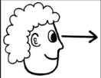


Relationships & Cardinalities
Receive
Interpretation:
EMPLOYEES
PAYCHECK
One entity instance in class EMPLOYEES is related to minimum 1 and maximum 1 entity instance in class PAYCHECK
i.e. One EMPLOYEE receives one and only one PAYCHECK in a month.
Receive
Interpretation:
EMPLOYEES
PAYCHECK
An entity instance in class PAYCHECK is related to minimum 1 and maximum 1 entity instance of class EMPLOYEE.
i.e. One PAYCHECK is being sent to one and only one EMPLOYEE in a month.

Slide 18
Relationships & Cardinalities
Combined Interpretation:
COURSE
CourseID
Title
Offer
STUDENT
AdminNo
StudName
DOB
Enroll
A course can accept zero (minimum) or many (maximum) students.
A student can enroll into one (minimum) and only one (maximum) course.

Slide 19
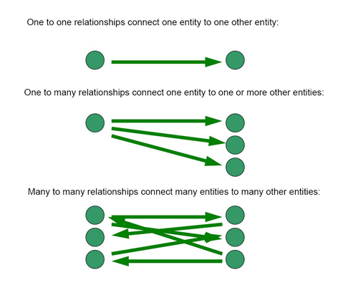
Relationships & Cardinalities
In modelling, we shall focus on the maximum cardinalities in both entities. In this example;
- The one-to-many or many-to-one type of relationship (referring to the maximum cardinalities only).
Relationship | Notation | Instances in entity classes
1:1, one-to-one (one and only one)
1:N, one-to-many
M:N, many-to-many
(Max ---- Max)
Three types of relationship:
Receive
EMPLOYEES
PAYCHECK
CUSTOMERS
Set Up
ACCOUNTS
STUDENTS
Enroll
MODULES

Slide 20
Relational Model - Relationships
One-to-One (1 : 1), One and only one)
EMPLOYEES
Receive
PAYCHECK
Entity: EMPLOYEE
Entity: PAYCHECK
Peter
a1
b1
PC_PR-02
Rosidah
a2
b2
PC_RD-03
Raymond
a3
b3
PC_RH-02
Kelly
a4
b4
PC_KY-03

Slide 21
Relational Model - Relationships
One-and-One (1 : 1)
EMPLOYEES
Receive
PAYCHECK
Entity: EMPLOYEE
Entity: PAYCHECK
Emp_ID | EName | Designation
P622 | Peter | Engrg Mgr
Q583 | Rosidah | QA Exec
E563 | Raymond | Machinist
S754 | Kelly | Sales Exec
PayCode | Amount | Emp_ID
PC_PR-02 | 5000 | P622
PC_RH-02 | 4200 | E563
PC_RD-03 | 3200 | Q583
PC_KY-03 | 3800 | S754
one EMPLOYEE receives one PAYCHECK
one PAYCHECK is set for one EMPLOYEE.

Slide 22
Relational Model - Relationships
One-to-Many
Set Up
CUSTOMERS
ACCOUNTS
Entity: CUSTOMERS
Entity: ACCOUNTS
Judy
a1
b1
FD_130-02
a2
b2
SV_130-12
Winnie
a3
b3
SV_140-33
b4
INV_15-66
This is a 1:M (one-to-many) binary relationship.

Slide 23
Relational Model - Relationships
One-to-Many
CUSTOMERS
Set Up
ACCOUNTS
Entity: CUSTOMER
Entity: ACCOUNTS
Cust_ID | CName
C8532 | Judy
C8533 | Brayan
C8534 | Sandra
C8535 | Winnie
AccCode | Amount | DateCreated | Cust_ID
FD_130-02 | $5,000 | 25-Oct-2008 | C8532
SV_130-12 | $1,200 | 12-Jul-2006 | C8532
FD_126-03 | $20,000 | 10-May-2005 | C8533
SV_132-11 | $2,000 | 24-Jun-2006 | C8533
SV_130_20 | $3,200 | 09-Aug-2006 | C8534
SV_140-33 | $4,000 | 23-Dec-2006 | C8535
INV_15-66 | $25,000 | 08-Mar-2007 | C8535
one Customer has many Accounts.
one Account is for one Customer only.

Slide 24
Relational Model - Relationships
Many-to-Many
STUDENTS
Enroll
MODULES
Entity: STUDENT
Entity: MODULES
Chris
a1
b1
IT1761
Joyce
a2
b2
IT1762
Rose
a3
b3
IT1764
Steve
a4
b4
IT1766

Slide 25
Relational Model - Relationships
Many-to-Many
STUDENTS
Enroll
MODULES
AdminNo | StudName | ModID
151111A | Chris | IT1761
151111A | Chris | IT1762
152222B | Joyce | IT1761
152222B | Joyce | IT1762
153333C | Rose | IT1764
153333C | Rose | IT1766
154444D | Steve | IT1766
ModID | Description | Semester
IT1761 | CompMaths | S1
IT1762 | DSA | S1
IT1764 | CommSkills | S1
IT1766 | InnoProj | S1
ER Diagram, reference source: https://www.youtube.com/watch?v=ZBgXb66Ckz0

Slide 26
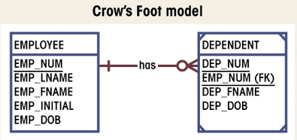
Entity types & Relationships
Strong entities
A strong entity is an Existence-Independent entity. It can exist in the database independently.
Set Up
CUSTOMERS
ACCOUNTS
Both ‘CUSTOMERS’ & ‘ACCOUNTS’ are strong entities
Entity : EMPLOYEE
Entity : DEPENDENT
(Weak entity)

Slide 27
Entity types & Relationships
Strong & Weak entities
A weak entity is an entity whose instance cannot exist in the database without the existence of an instance of a strong entity.
(i.e. It is an existence-dependent entity. It can exist only when it is associated with another related entity occurrence.
EMPLOYEES
support
DEPENDENTS
(Weak entity)
‘DEPENDENTS’ is a weak entity, it cannot exist without entity ‘EMPLOYEES’

Slide 28
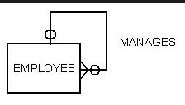
Entity types & Relationships
Recursive Relationship
A Recursive relationship is a relationship between an entity and itself. It is an unary relationship.
Manages
EMPLOYEES
EmpID
EmpName
Gender
Supervisor
EMPLOYEES
EmpID | EmpName | Gender | Supervisor
E1 | Kenny | Male | Trump
E2 | Katty | Female | Kenny
E3 | Tina | Female | Kenny

Slide 29
Entity types & Relationships
Super-type & Subtype entities
A Super-type entity has got the parent-child relationship with one or more subtypes and it contains attributes that are common to its subtypes.
Subtypes are subgroups of the super-type entity. They have unique attributes but they will be different from each subtype.
CLIENTS
ClientID
ClientName
AmountDue
(These attributes common to all subtype entities)
IndividualCLIENT
Profession
Address
CorporateCLIENT
DateTransact
PaymentClass
GSTRegisNo
OverseasCLIENT
PersonContact
CountryID

Slide 30
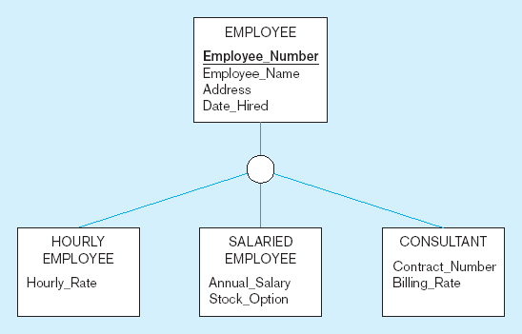
Super-type & Subtype Entities
Another example of Super-type, Subtype Entities
Super-type Entity :
By Generalization hierarchy
- Super-type has shared attributes
- Sub-types have unique attributes
Common attributes to all sub-type entities
Sub-type Entities
Elements of data model includes:
Note that unique attribute ‘Employee_Number’ together with common attributes ‘Employee_Name’, ‘Address’ & ‘Date_Hired’ in the Super-type entity.
While each sub-entity attached with unique attributes to themselves.

Slide 31
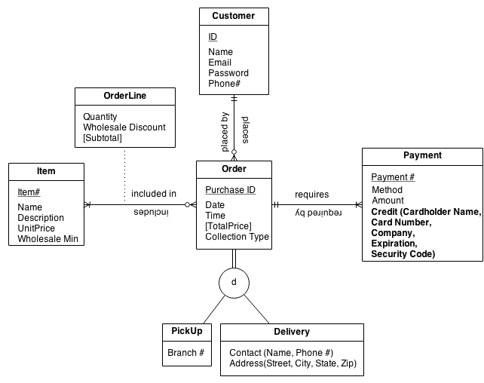
Entity Relationship Diagram (ERD)
Entity Relationship Diagram (ERD) with Super-type & Subtype entities
Entity Relationship Diagram

Slide 32
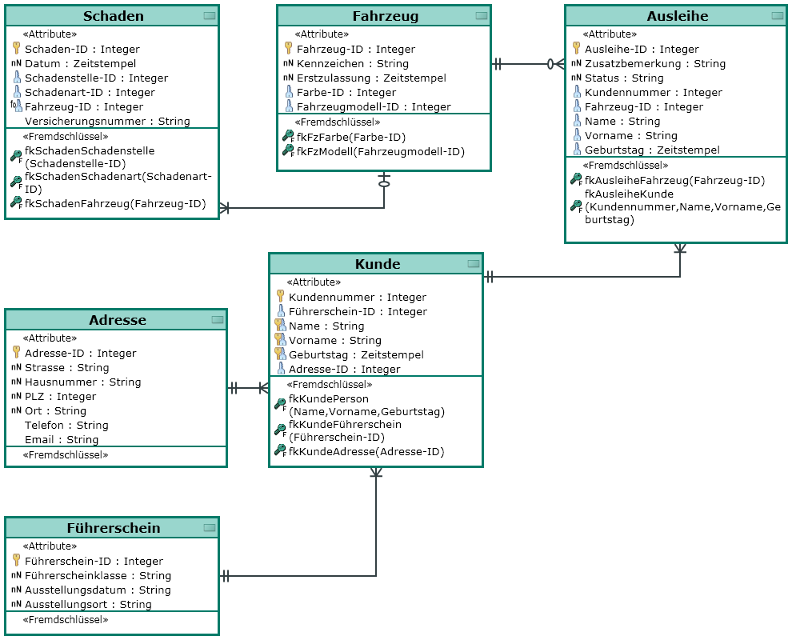
Entity Relationship Diagram

Slide 33
Review Questions
WORKSHOP
ShopID
ShopAddr
Speciality
Mgr Phone
VEHICLES
VehNum
VehModel
Engine
Repair
Speciality
Name one Entity
Name one Attribute
Indicate the degree of Relationship
Indicate a Cardinality
Max. cardinality at Workshop
Type of relationship in ERD
Action word
Possible PK in VEHICLES entity
VEHICLES
Binary Relationship
Engine
VehNum
One-to-One
Repair
Many-to-Many
ShopID
WORKSHOP

Slide 34
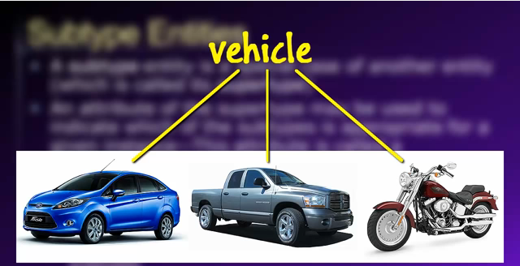
Review Questions
Super-type , Subtype Example:
VEHICLES
RegNum
VehType
VehModel
OMV
EngineCC
NoOfWheel
NoOfDoor
NoOfPassenger
CarryLoad
Price
VEHICLES
RegNum
VehModel
OMV
EngineCC
Price
MOTORBICYCLE
NoOfWheel
CARS
NoOfPassenger
NoOfDoor
TRUCKS
NoOfWheel
CarryLoad
Name the type of relationship
Name the super-type entity
Name one sub-type entity
Name the common attributes
CARS
VEHICLES
TRUCK
Super & Subtype
RegNum
VehModel

Slide 35
End of Topic 4

Slide 36
Review Questions
VEHICLES
RegNum
VehType
VehModel
OMV
EngineCC
NoOfWheel
NoOfDoor
NoOfPassenger
CarryLoad
Price
VEHICLES
RegNum
VehModel
OMV
EngineCC
Price
Legend:
Complete category
Super-type , Subtype Example:
incomplete category
MOTORBICYCLE
RegNum
NoOfWheel
CARS
RegNum
NoOfPassenger
NoOfDoor
TRUCKS
RegNum
NoOfWheel
CarryLoad
Name the type of relationship
Name the super-type entity
Name one sub-type entity
Name the common attributes

Slide 37
Relational Model – Super-Types & SubTypes
Another Super-type , Subtype Example:
VEHICLES
RegNum
VehModel
OMV
EngineCC
Price
Legend:
VEHICLES
RegNum
VehType
VehModel
OMV
EngineCC
NoOfWheel
NoOfDoor
NoOfPassenger
CarryLoad
Price
Complete category
incomplete category
MOTORBICYCLE
RegNum
NoOfWheel
CARS
RegNum
NoOfPassenger
NoOfDoor
TRUCKS
RegNum
NoOfWheel
CarryLoad

